Slide 1
Jermyn Borough Council Meeting
09/19/19

Slide 2
Meeting Agenda
Call to Order
Pledge of Allegiance
Roll Call
Previous Meeting Minutes
Treasurer’s Report/Bills Payable
Correspondence
Public Comment
Reports
Reports of Committees
Woodlands Sewer Bids
Awarding of Garbage/Recycling Bid
Insurance
Alternate Parking Ordinance
Borough Phone System
New Business
Adjournment

Slide 3
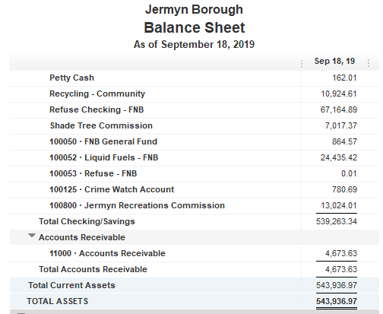
Treasurer’s Report

Slide 4
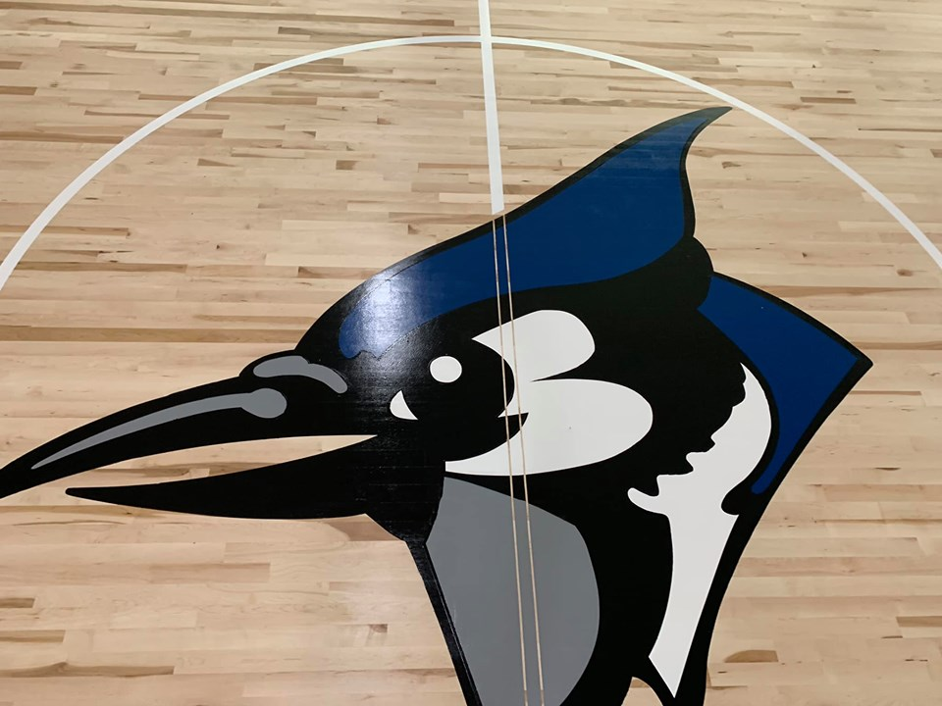
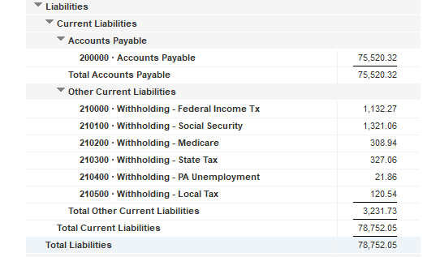

Slide 5
